Slide 1

Cohort 4 Q2. Loans Default Predictive Analysis
Presented by:
JEAN AMENYAGLO

Slide 2

This project is designed to help the collection team in the borrower's department to determine and predict, whether the loans will be rolled over or not based on specified criteria.
Predict whether the loan rolled or not rolled
What is your prediction accuracy
Overview:

Slide 3
Objectives
The objective of this project is to predict, if borrower loans will be rolled over from an early due stage
(1-30 days delinquency) to a later due stage (31-60) .

Slide 4
Data Report
The dataset contains the following details:
There are 5783 observations and 11 columns.
There were some missing value in the data, ie. Monthly_income,TOB_months,closing_principal_balance,original_loan_amount and a few others.
Also, there are a mix of numerical and categorical variables.
.

Slide 5
Data Report
The Dataset
The dataset contains the following information about 5783
loan_id: Unique loan identifier
monthly_income: borrower's monthly income
origination_score_band: score tier band at the moment of loan's origination
TOB_months: Age in months at the moment the loan entered early delinquency
closing_principal_balance: The loan's closing balance at the moment the loan entered early delinquency
original_loan_amount: The loan;s original amount
product: Product line (the portfolio has multiple products)
original_loan_term: The loan's original term in months
remaining_loan_term: The loan;s reamining in months at the moment the loan entered early delinquency
deliq_history: The loan;s previous 6 months of delinquency history at the momet the loan entered early delinquency.The value are separated by commas. The first value from left to right represents the most recent historical value(i.e. 1 month before entering early delinquency) The 2nd value from left to right represents the delinquency two months before early delinquency and so on) 1: 1-30 days delinquency. 2: 31-60 days delinquency and so on
target: Indicate whether the loan rolled forward into later stage delinquency or not (1: rolled, 0: not rolled)

Slide 6
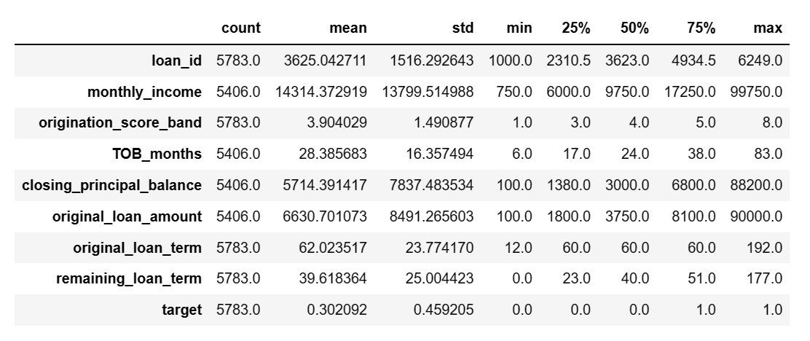
Initial Exploratory Data Report Analysis

Slide 7
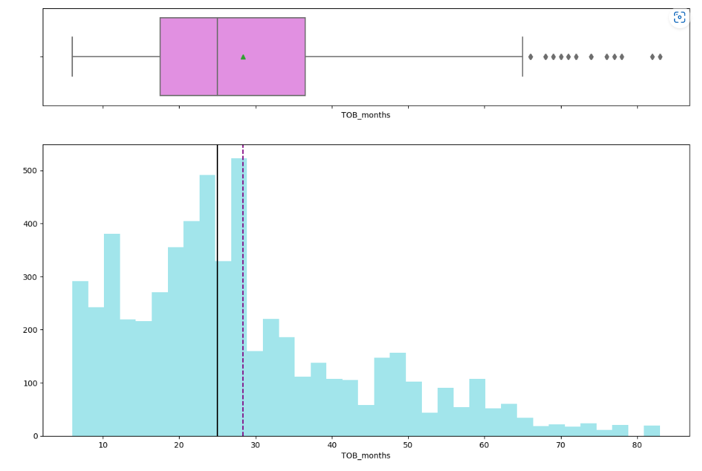
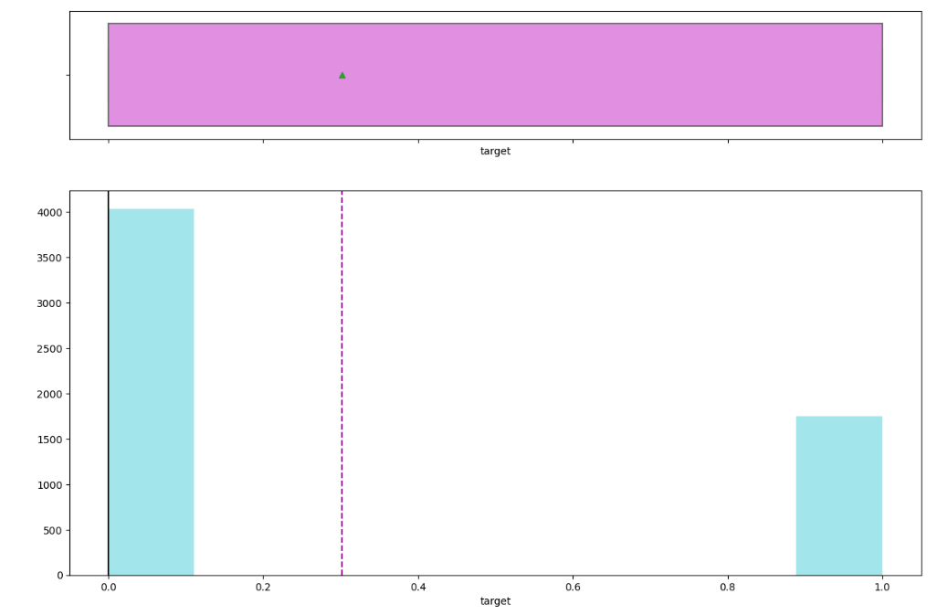
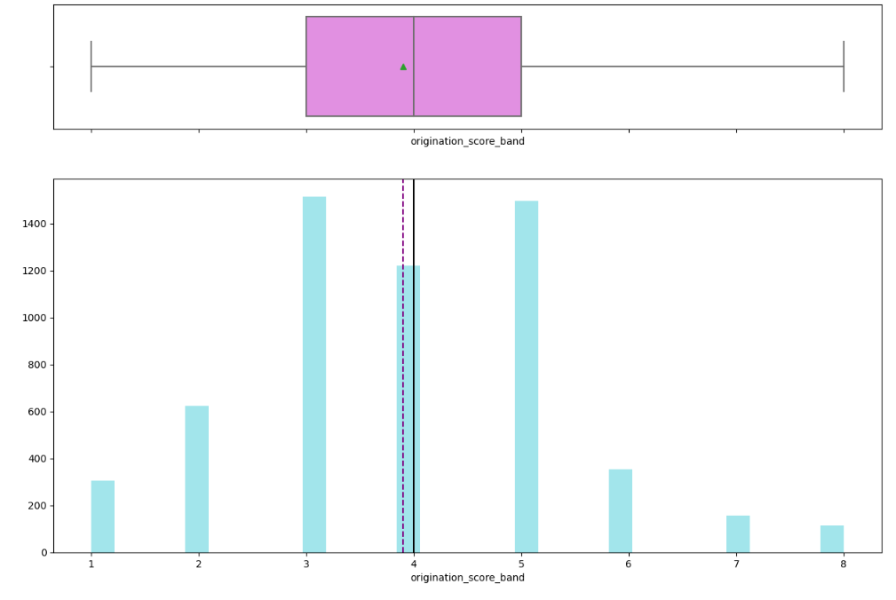
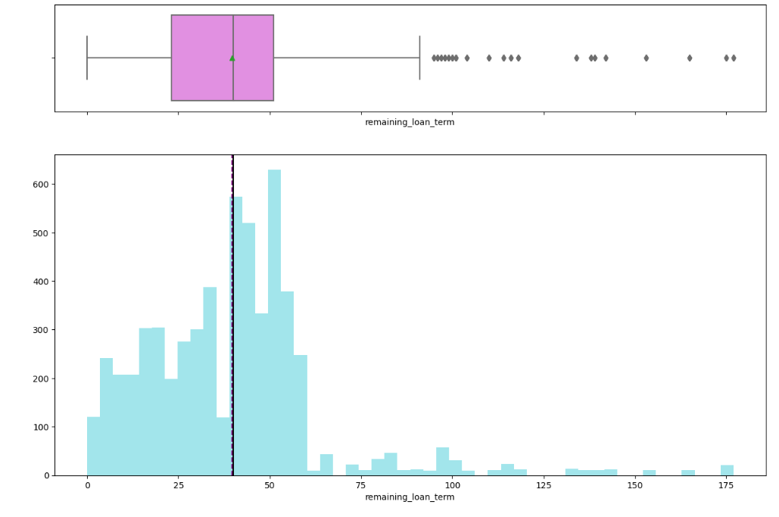
EDA - Univariant Analysis

Slide 8
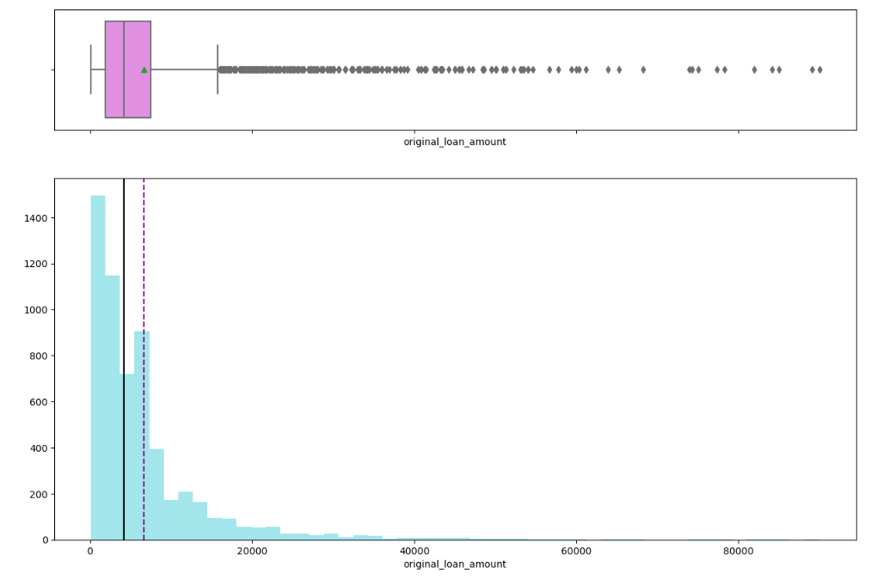
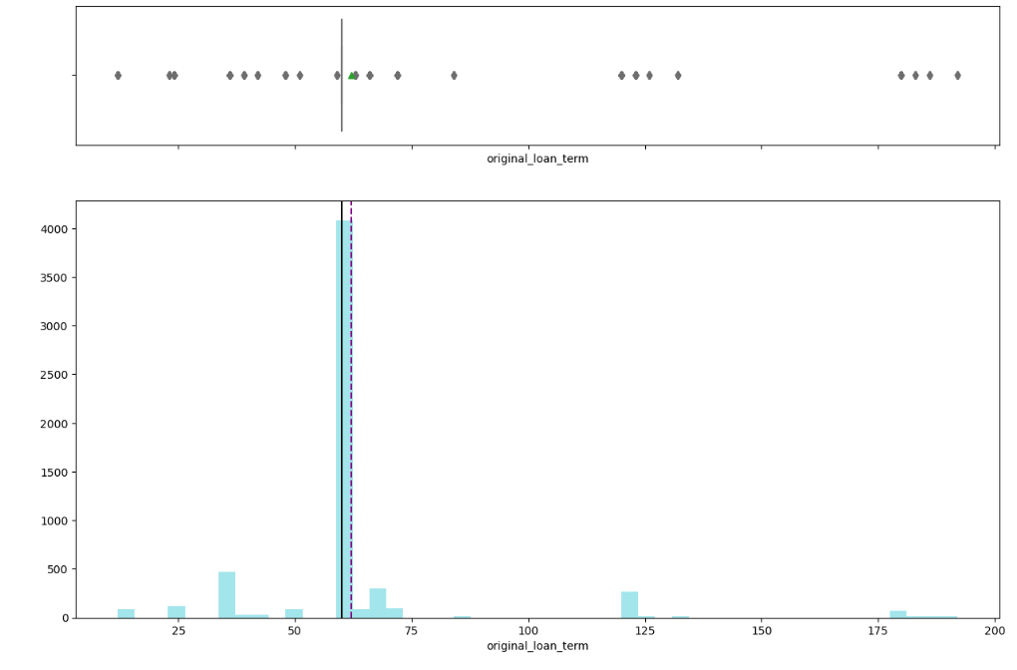
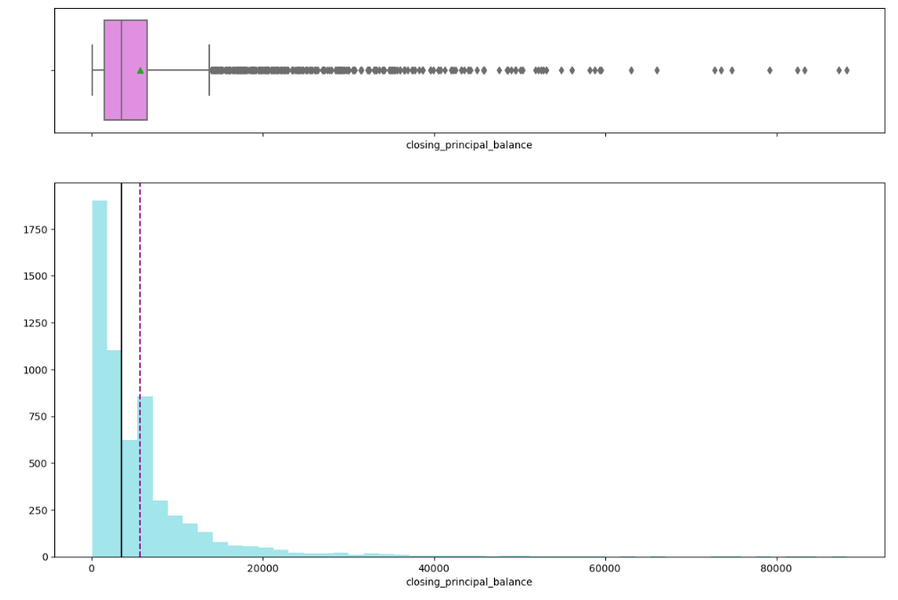
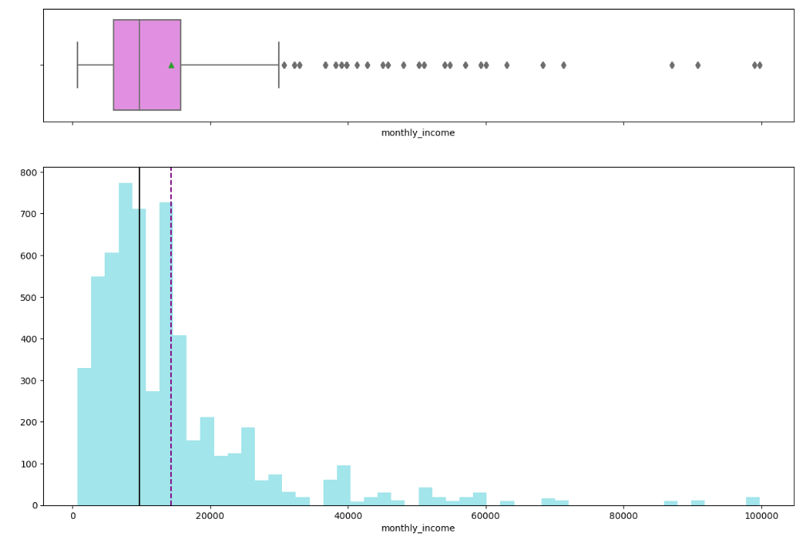
EDA - Univariant Analysis cont.

Slide 9
Observation on Univariant Analysis.
Monthly Income is skewed with the mean of$15,000 and a max of $100,000.
Original score band is distributed across with mean of 4 and max of 8.
TOB Months left skewed with mean of 29 and max of 83.
Closing principal balance is left skewed with mean of $6000 and max of $89,000
Original loan amount is left skewed $6,700 and a max of $90,000.
Original loan term has a mean of 62 term and max of 192 term
Remaining loan term mean is 39 days and a max of 177 days

Slide 10
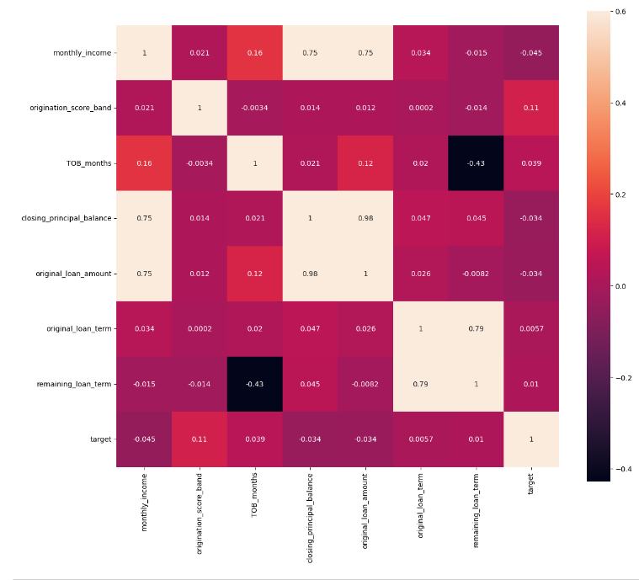
Exploratory Data Analysis

Slide 11
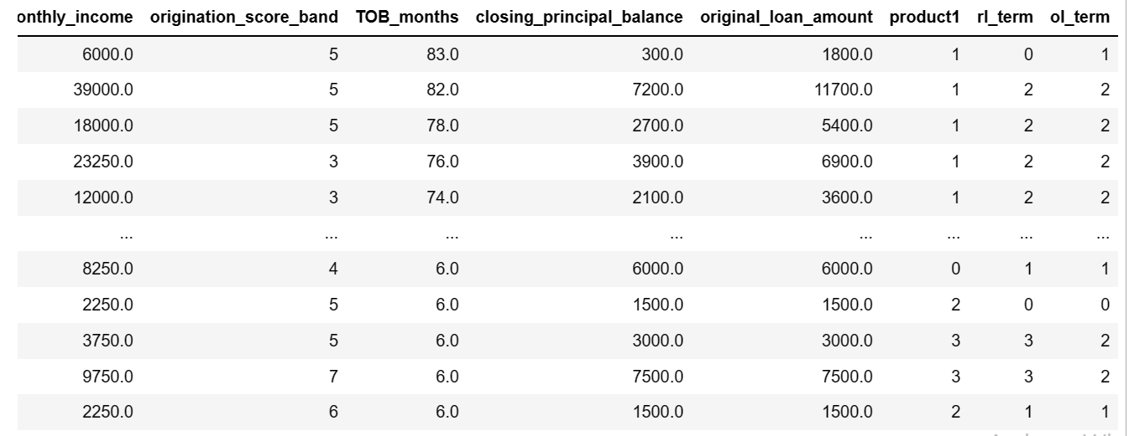
Data Pre- Processing :Variable transformation “Converting category features to label encoder”

Slide 12
Modeling Process : Validation and Interpretation
The data containing the target variable is being split into train and test data
The purpose of creating subset of training and test data set is to create a model based on train data an validate the built model using the dataset.
The industry best practice state:
The training and testing are too different to avoid overfitting.
80% into train data and 20% test data
Kfold cross validation has been adopted to bring in the benefits of multiple random splits of dataset into training and testing.
This is used to prevent overfitting of the model
Also used to determine the optimal parameters of the model.

Slide 13
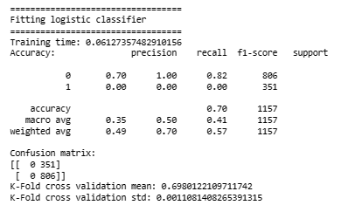
Modeling Process : Validation and Interpretation
The objective here is to determine whether the loa will roll or not roll.
The dataset contains target variable
”0 and 1”, where 1 means rolled and 0 not rolled.
In this instance, supervised learning algorithm needs to be applied for this prediction.
The algorithms applied is
Logistic Regression, which is a type of classification that estimates discrete values like 0 and 1,yes/no, true/false etc.

Slide 14
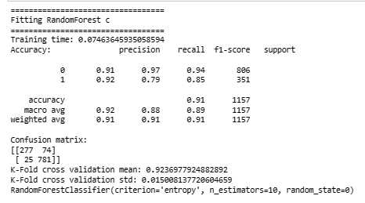
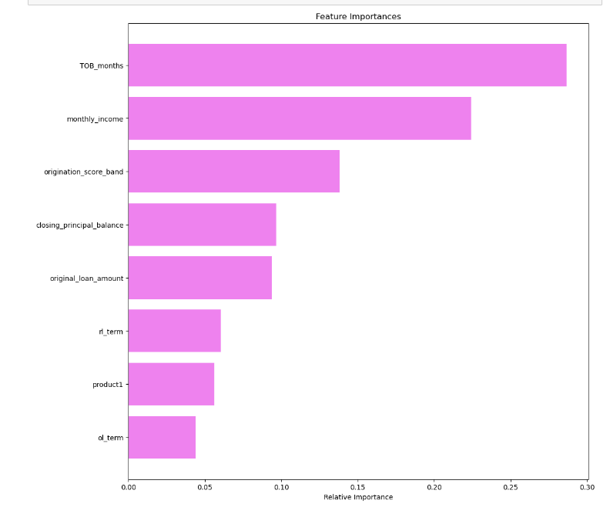
Modeling Process : Validation and Interpretation
The objective here is to determine whether the loa will roll or not roll.
The dataset contains target variable
”0 and 1”, where 1 means rolled and 0 not rolled.
In this instance, supervised learning algorithm needs to be applied for this prediction.
The algorithms applied is
Logistic Regression, which is a type of classification that estimates discrete values like 0 and 1,yes/no, true/false etc.

Slide 15
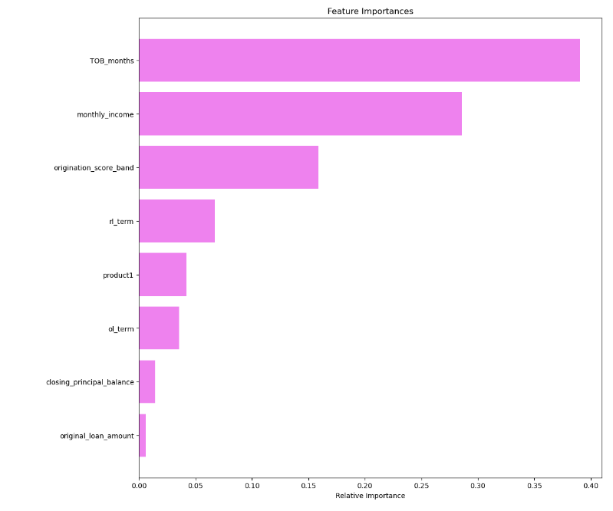
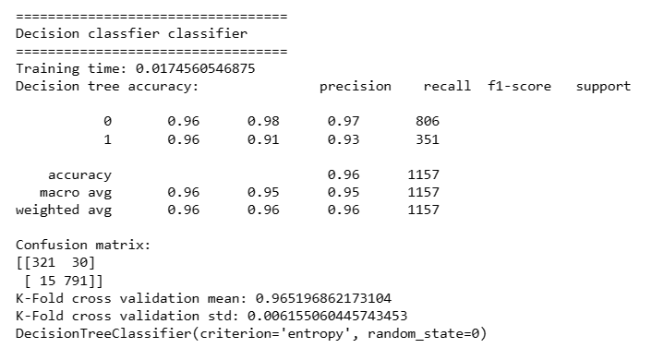
Modeling Process : Validation and Interpretation

Slide 16
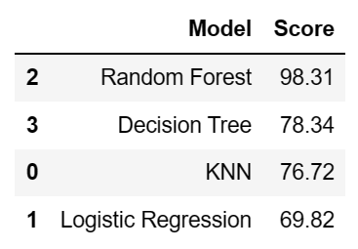
Interpretation from the best model

Slide 17
Interpretation for the best model cont.
Logistic Regression Model, KNN, Random Forest and Decision Tree can be used to predict the probability of a loan being rolled or not rolled with the good accuracy.
From our analysis, Random Forest came out as the best model that gives the probability the loan will not roll forward into later stage of delinquency.
From Decision Tree, we are focusing on the future importance variables which needs to be focused and, what the probability rate to be considered based on recommended decision.
In relation to implementation, Collections teams in the borrower's department has suggested to adopt the three-pronged approach to customers. Based on the model interpretation metrics.

Slide 18
Recommendations and Insights
Below are the final interpretation:
The objective we have here is the Collections team in the borrower's department is looking for a predictable model to predict the probability that a customer loan will be rolled or not rolled.
Based on the order of important, Random Forest came out as the best model.

